Slide 1


Team 24: Pyro Sensor
Bi-Weekly Update 2 Alfonso Wong
Martin Ford
Oscar Hernandez Sponsor: Rhett Guthrie TA: Niloofar Borzooei
Notes:
Michelle

Slide 2
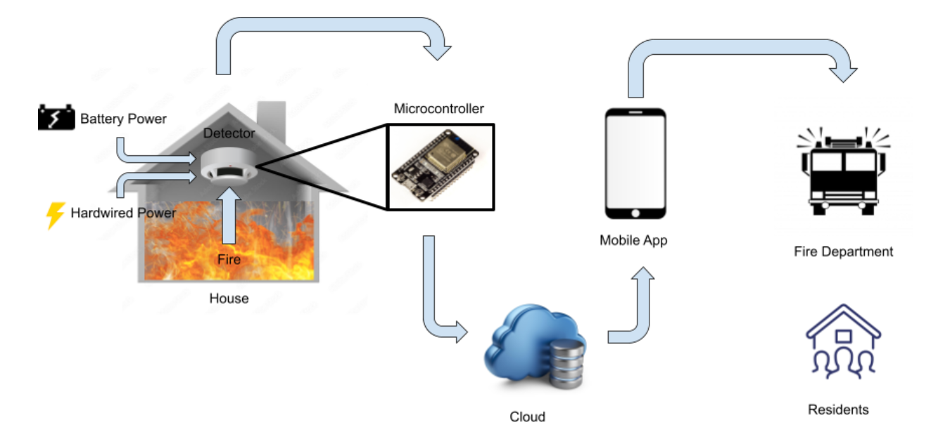
Project Summary
Problem statement:
Modern smoke detectors do not directly notify the emergency responders
Fire department has limited data of residents in buildings
Our Pyro Sensor will:
Notify any user and emergency responders instantly through a mobile app of any incident
Give fire department information about residents and pets
Notes:
Kyle

Slide 3
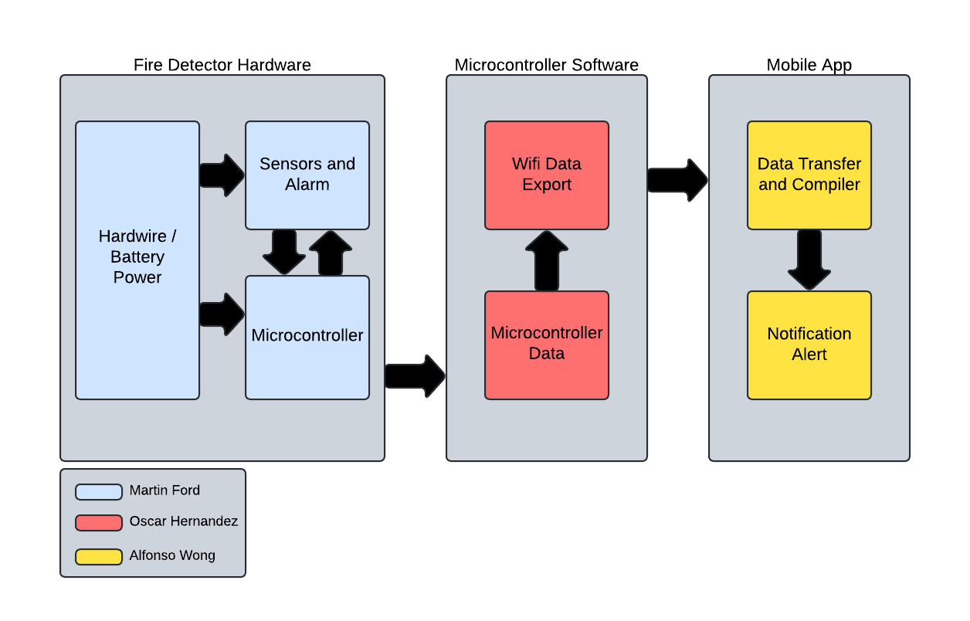
Project/Subsystem Overview
Hardware
Collects sensor data and sends it to microcontroller
MC Software
Gets sensor data, calculates it and sends it to mobile application
Mobile Application
Displays sensor information and will alert users and Fire Department in case of fire alert.
Notes:
Eric

Slide 4
Major Project Changes for 404
Hardware
N/A
MC Software
N/A
Mobile Application
Alerting 911 central dispatcher instead of directly fire department
Notes:
i don’t think we need this slide

Slide 5
Project Timeline
 | ECEN 403 | 02/03 | Date
App works in customers side, can create account |  |  | 12/03
workspace, display sensor info, read/write to database |  |  | 12/03
Power is successfully delivered to full PCB |  |  | 12/03
Some sensors work and deliver signals |  |  | 12/03
MCU code establishes connection with app’s subsystem database, and sends sensor data to it. |  |  | 02/03
Fix/update notification System, picture upload |  |  | 02/03
Switch communication to centralized dispatcher |  |  | 02/03
Fix PCB schematic mistakes |  |  | 02/03
Reorder and resolder PCB |  |  | 02/03
Ensure all sensor modules are functional |  |  | 02/03
Final MCU-app integration |  |  | 02/17
Notes:
Eric

Slide 6
Hardware Subsystem
Martin Ford
Accomplishments since last update 15 hrs of effort | Ongoing progress/problems and plans until the next presentation
Optimize schematic per integration tests | Fix schematic errors Reorder and resolder PCB Get all sensor modules to deliver signals to the MC

Slide 7
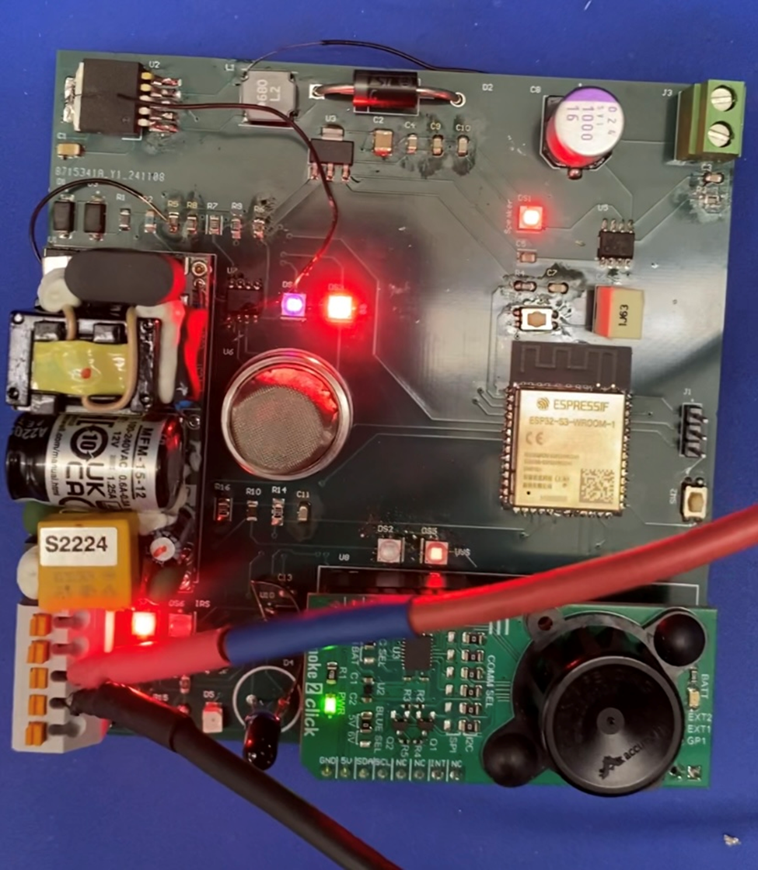
Hardware Subsystem
Martin Ford
What works:
Power distribution to full PCB
Speaker makes sound from signal
IR sensor module delivers signal to microcontroller
What does not work:
Speaker sound needs greater amplification
UV, gas, and photoelectric sensor modules do not consistently deliver signals to microcontroller

Slide 8
Microcontroller Software Subsystem
Oscar Hernandez
Accomplishments since last update 25 hrs of effort | Ongoing progress/problems and plans until the next presentation
Built the MCU file that retrieves the user’s Firebase credentials (Database URL and API Key), and Wi-Fi’s SSID, and password through Bluetooth. Established connection with app subsystem’s database. Updated sensor code to account for changes in PCB design. | Integration of MCU-app by matching the data format from MCU with the app’s GUI. Correct software errors that pop up from flashing code to hardware subsystem.

Slide 9
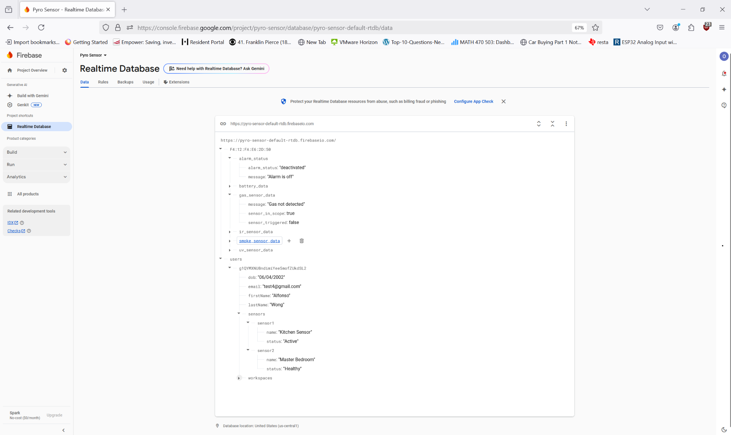
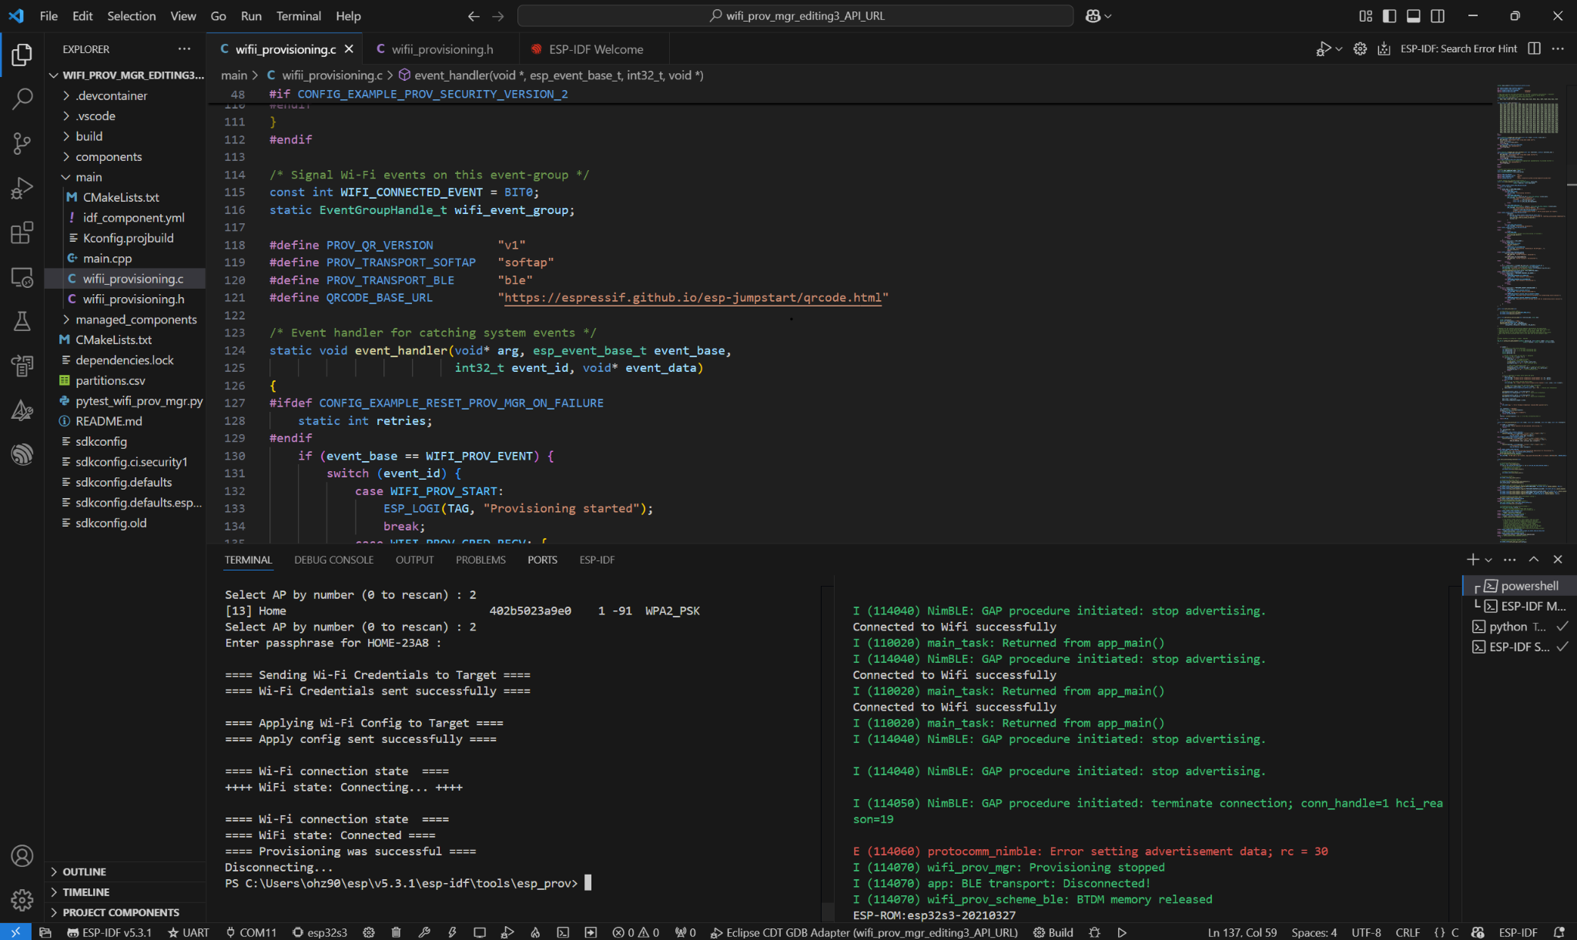
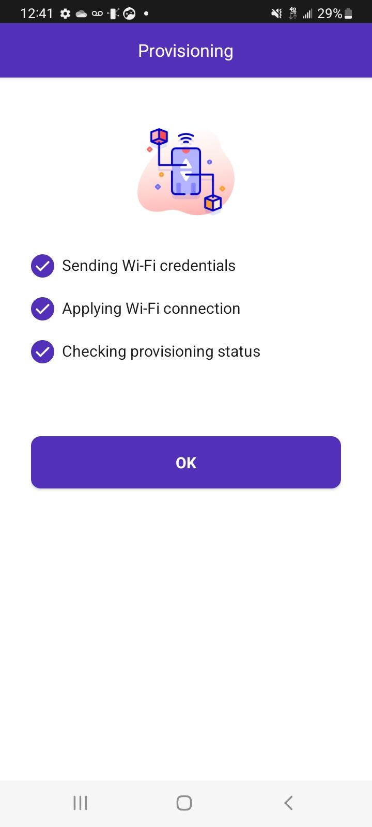
Microcontroller Software Subsystem
Oscar Hernandez
Current MCU-app Database (without proper formatting)
Provisioning through Python script
Provisioning through public Android app

Slide 10
Mobile Application Subsystem
Alfonso Wong
Accomplishments since last update 22 hrs of effort | Ongoing progress/problems and plans until the next presentation
The mobile application is back up and running and able to pull data from the database (Firebase) MC can access mobile app database UI feature for adding device to app finished Pictures can know be uploaded | Method for firefighters to access application Picture not showing up on firebase MC be able to access sensor part of database Mobile app display real time sensor data What API to use for contacting central dispatch(text or email?)

Slide 11
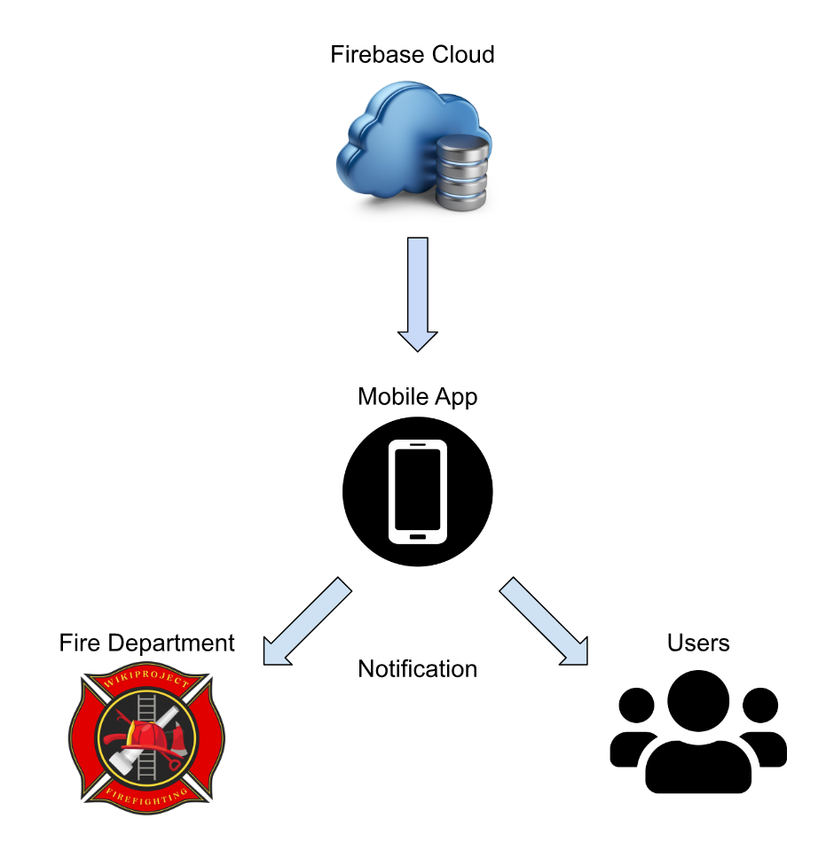


Mobile Application Subsystem
Alfonso Wong
Functioning
User account creation
Gets users information (name, age, address, type of building, expected occupants, etc.)
Database (writing/reading data)
Sensor display on app
Non-Functioning
Communication to 911 central dispatcher
How firefighters can access user information
Function to add device to app
Central Dispatcher

Slide 12
Subsystem Integration
Accomplishments since last update 8 hrs of effort | Ongoing progress/problems and plans until the next presentation
Schematic optimized for integration MCU can access mobile app database | Flash ESP32 with code Contact between MC and mobile app using bluetooth MC can access user’s sensor data and write to it
Notes:
could be merged to subsystem slides

Slide 13
Subsystem Integration
What works:
MCU can access main database
What does not work:
Code does not successfully flash to microcontroller
MC cannot access user data
Notes:
could be merged to subsystem slides

Slide 14
Parts Ordering Status
Hardware Subsystem Parts Status
Reorder parts needed or parts not already bought in bulk:
Fixed PCB
Tactile buttons
Microcontroller and Network Subsystem Parts Status
Order additional MCUs to simulate network nodes as needed
Mobile Application Subsystem
If needed, I will pay for the subscription to APIs. (~$2/month)
Notes:
don’t think we need this slide

Slide 15
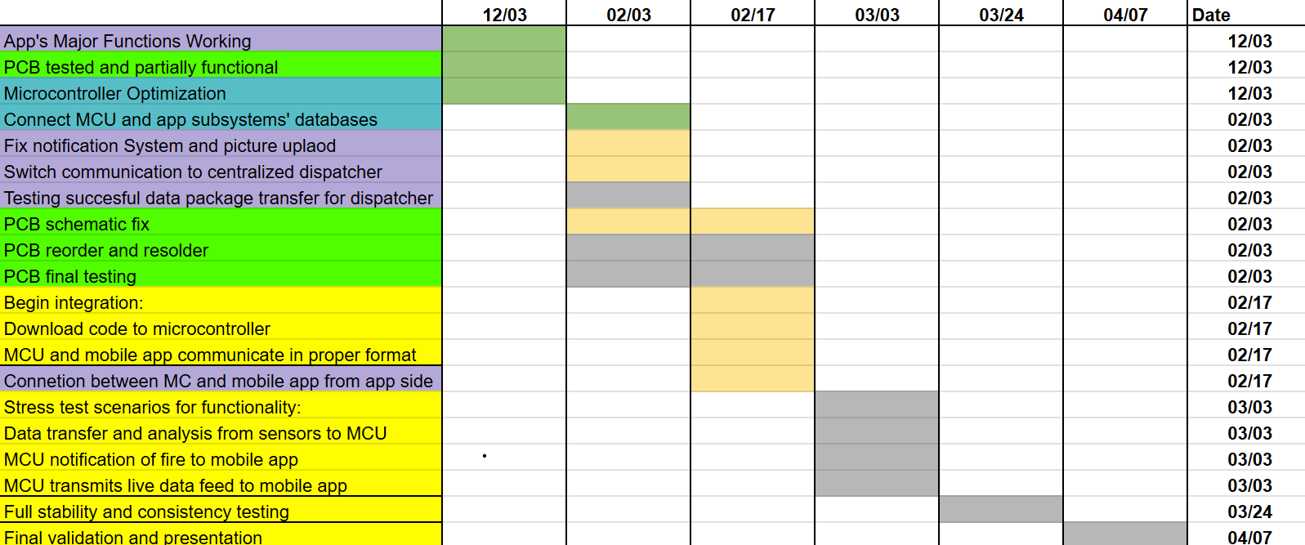
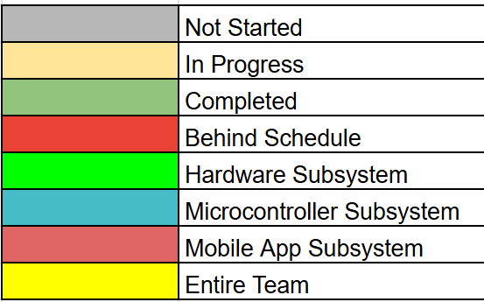
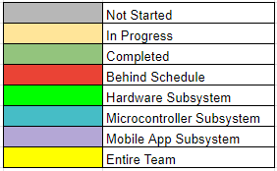
Execution & Plan
Notes:
Michelle

Slide 16
Validation Plan
Test Name | Success Criteria | Status | Responsible Engineers
Sensor Functionality | Sensors detect smoke/flame at expected ranges and output a signal. | Untested | Martin Ford
Speaker Functionality | Speaker emits sound from signal at >80 dB. | Untested | Martin Ford
Operating Time | System operates and receives full power continuously for 1 hour on each power source. | Untested | Martin Ford
Network | MCU is able to aggregate all sensor data to the gateway. | Tested | Oscar Hernandez
Trouble Signal | MCU sends trouble signal to app for malfunctioning node. | Tested | Oscar Hernandez
User Profile Creation | User is able to create an account and be able to sign in. | Tested | Alfonso Wong
Push Notifications | Be able to push notifications to both users and firefighter department. | Untested | Alfonso Wong
Design UI | Have a working UI and test with emulator. | Tested | Alfonso Wong
Integrate Cloud Service | Mobile app has ability to pull data from cloud service and display it. | Tested | Alfonso Wong

Slide 17
Validation Plan
Test Name | Success Criteria | Status | Responsible Engineers
Picture Upload | User can Upload pictures to profile. | Untested | Alfonso Wong
MCU Peripherals Interface | MCU reads signals from all sensors, and activates/deactivates alarm. | Untested | Martin Ford & Oscar Hernandez
Device and Application Communication | Device(sensor) can be added to user profile in application. | Untested | Alfonso Wong & Oscar Hernandez
Real Time Communication | MC is feeding constant information to database and it is being displayed in real time in mobile application. | Untested | Alfonso Wong & Oscar Hernandez
Trigger Warning from MC | MC must send a tigger alert of ongoing event and application must send notification to user and dispatch | Untested | Alfonso Wong & Oscar Hernandez
Early Fire Detection | The system reduces the propagation of a fire by minimizing false alarms and notifying the user or fire department as soon as a fire is detected. | Untested | All

Slide 18
Thank you for your attention!
Questions?

